Slide 1
IBM University Engagement Project Submission
“Exploring the Power of Agentic AI with IBM Granite and LangFlow”

Slide 2

Project Tile – Library AI Agent
Domain of Project – Education
Student Name | Recent Passport Photo | Email ID | Mobile number [WhatsApp]
Smriti Karmakar |  | smritikarmakar06@gmail.com | 7702493908

Slide 3
Problem Statement
Problem Statement : Library AI Agent
The Challenge
Students often spend considerable time searching for relevant books and academic resources in libraries. Traditional library systems provide limited search capabilities and do not offer personalized recommendations based on a student's academic needs, semester, or subject of interest.
Finding suitable learning materials, checking book availability, and identifying recommended resources can be time-consuming and inefficient. Students need an intelligent system that can understand natural language queries and quickly provide accurate and relevant book suggestions.
The Objective
Build an AI-powered Library AI Agent that assists students in discovering learning resources and accessing library information efficiently. The solution should:
• Natural Language Search – Allow students to search for books using conversational queries.
• Book Recommendation System – Suggest books based on subjects, semesters, and learning requirements.
• Author and Subject Search – Help users find books by author name or subject area.
• Book Availability Check – Provide information about whether a book is available or currently issued.
• Semester-wise Recommendations – Recommend books relevant to a student's academic semester.
• Knowledge-Based Retrieval (RAG) – Retrieve information from the library knowledge base and generate accurate responses.
• Personalized Learning Support – Guide students toward appropriate learning materials for academic growth.
• AI-Powered Library Assistance – Improve accessibility, engagement, and utilization of library resources through intelligent interactions.

Slide 4
Technology Used
Technology | Purpose
IBM watsonx.ai | Provides the AI platform for managing the Library AI Assistant and integrating AI capabilities.
IBM Granite Models | Understands user queries and generates intelligent responses about books, authors, subjects, and availability.
Retrieval-Augmented Generation (RAG) | Retrieves relevant information from the library dataset before generating accurate responses.
IBM watsonx Orchestrate | Creates, manages, and deploys the Library AI Assistant workflow.
Knowledge Base (Library Dataset) | Stores book details, author names, subjects, semester information, and availability status.
AI Agent | Interacts with students, answers queries, recommends books, and provides library information through natural language conversations.

Slide 5
Proposed Solution
Proposed Solution: Library AI Agent
The proposed solution is an AI-powered Library AI Agent built using IBM watsonx Orchestrate, IBM watsonx.ai, and Granite Models. The system helps students quickly discover relevant books and learning resources through natural language interactions.
At its core, the solution uses Retrieval-Augmented Generation (RAG) to retrieve accurate information from the library knowledge base. The library dataset contains book details such as title, author, subject, availability status, and semester information.
The system consists of the following key components:
Library AI Assistant – Acts as the main interface for students and understands natural language queries.
Knowledge Base – Stores library information including books, authors, subjects, availability, and semester-wise categorization.
Recommendation Engine – Suggests books based on subjects, semesters, and student learning requirements.
Book Search Module – Allows students to search books by title, author, or subject.
Availability Checker – Provides information about whether a book is available or currently issued.
Semester Recommendation Module – Recommends books relevant to a student's academic semester.
IBM watsonx Orchestrate manages the AI agent workflow, while IBM watsonx.ai provides AI capabilities and knowledge integration. Granite Models generate intelligent and context-aware responses.
Overall, the solution provides an intelligent digital library assistant that improves resource discovery, saves student time, and enhances access to academic learning materials.

Slide 6
Orchestrate component Used
Agent
Library AI Assistant
Main AI agent responsible for handling student queries.
Knowledge Source
LibraryBooksKnowledge
Connected to the library dataset and used for information retrieval.
Knowledge Base
Contains book titles, authors, subjects, availability status, and semester details.
Foundation Model
GPT-OSS 120B / IBM Granite Model
Generates intelligent responses based on retrieved knowledge.
Prompt Instructions
Defines agent behavior, book search rules, and recommendation logic.
Welcome Message
Provides an introduction to the Library AI Assistant.
Quick Start Prompts
Predefined queries for easy interaction and demonstration.
Chat Interface
Allows students to communicate with the AI agent using natural language.

Slide 7
Student Query
Orchestrate workflow
Library AI Assistant (IBM watsonx Orchestrate Agent)
Knowledge Base (Library Dataset)
RAG Retrieval
IBM Granite Model Processing
CGenerated Output: • Book Recommendations • Author Information • Subject-wise Books • Semester-wise Resources • Book Availability Statushat Input
Chat Response to Student

Slide 8
Architecture blueprint
Student
↓
Chat Interface
↓
Library AI Assistant (IBM watsonx Orchestrate)
↓
Knowledge Base (Library Dataset)
↓
RAG Retrieval
↓
IBM Granite Model
↓
Book Search & Recommendation Engine
↓
Book Details + Author Info + Availability Status
↓
Student Response

Slide 9
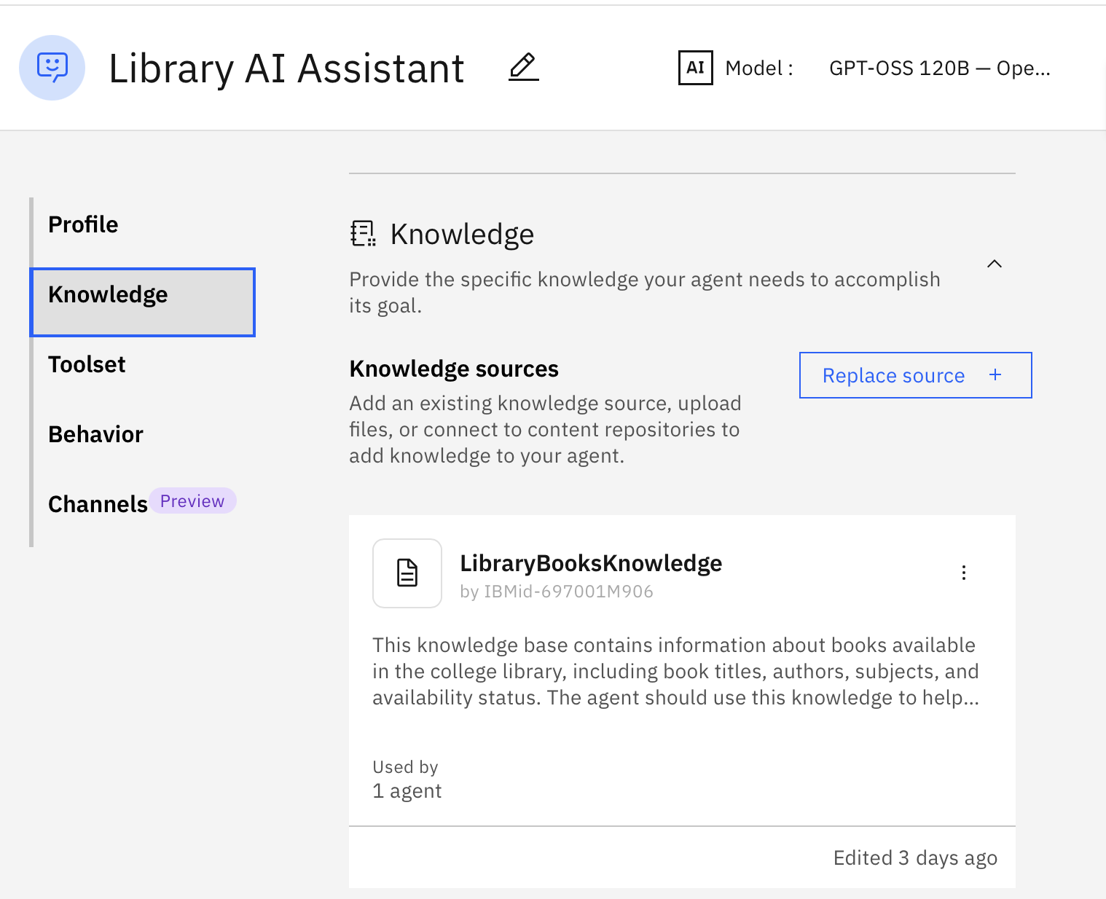
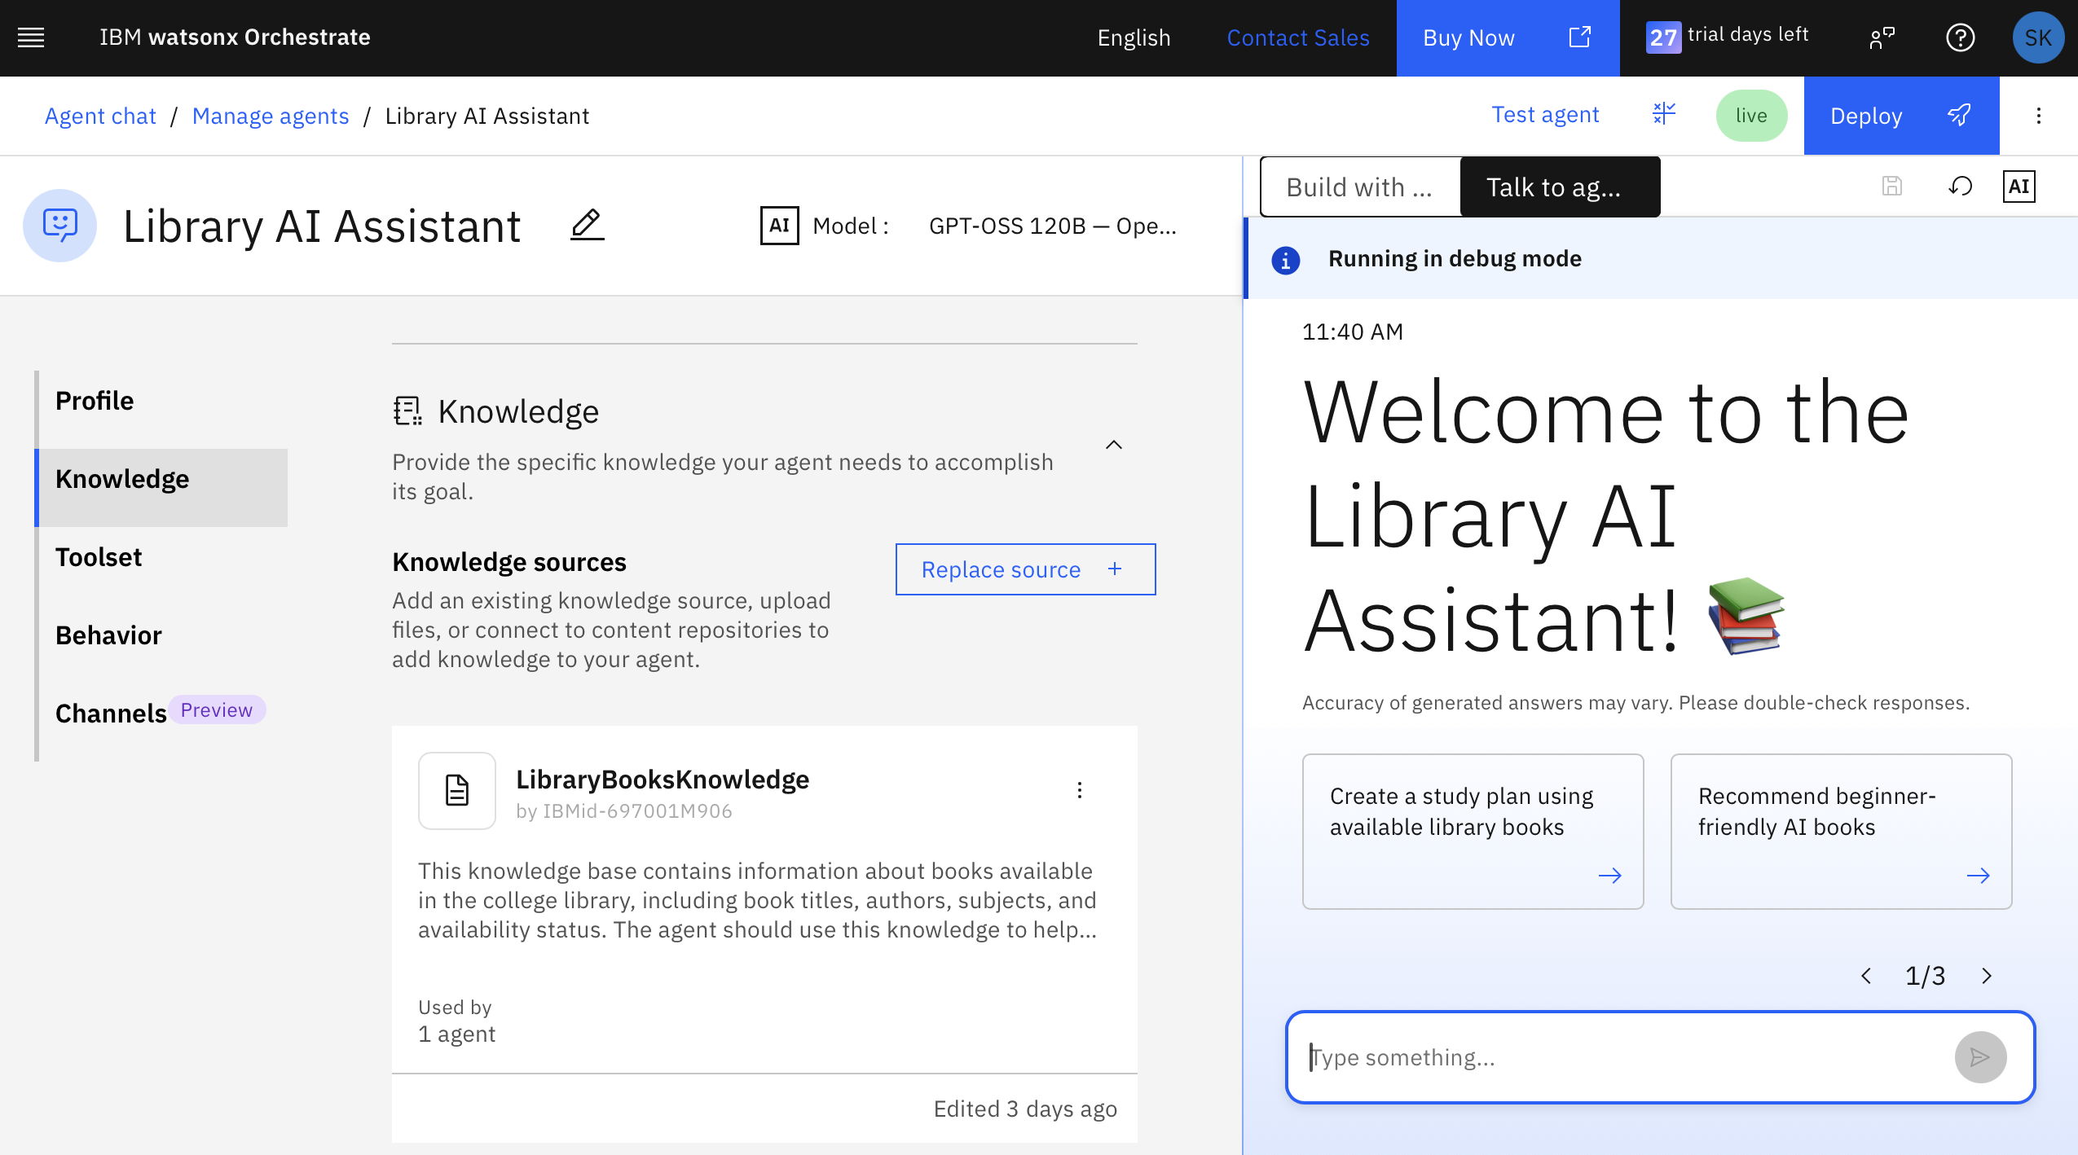
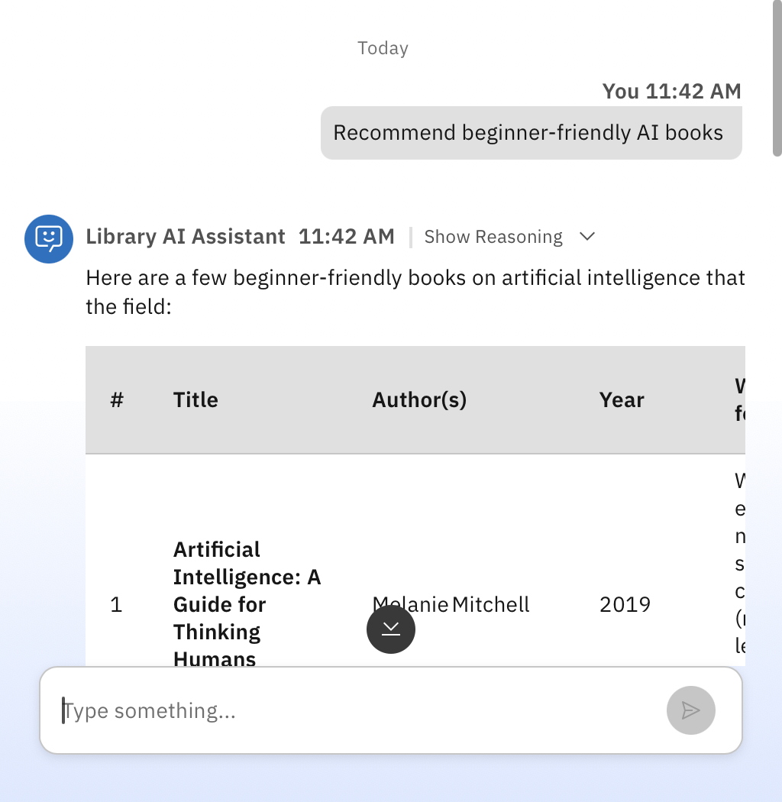
Results and Outputs
Knowledge Base Setup-
Agent Configuration-
User Input-

Slide 10
User Output-
# | Title | Author(s) | Year | Why It’s Good for Beginners | Availability (Campus Library)
1 | Artificial Intelligence: A Guide for Thinking Humans | Melanie Mitchell | 2019 | Written in an engaging, non‑technical style; explains core concepts (machine learning, neural nets, ethics) with real‑world examples. | Available – 3 copies (2 on shelf, 1 in the digital collection)
2 | Artificial Intelligence: Foundations of Computational Agents | David L. Poole & Alan K. Mackworth | 2021 (2nd ed.) | Provides a gentle introduction to the logical and probabilistic foundations of AI, with clear explanations and exercises. | Available – 1 copy on shelf
3 | AI Superpowers: China, Silicon Valley, and the New World Order | Kai‑Fu Lee | 2018 | Focuses on the societal impact of AI rather than heavy math; good for readers who want context and motivation. | Available – Digital PDF (library e‑resource)
4 | Deep Learning for Beginners: A Visual Introduction | Dr. Amit Kumar | 2022 | Uses visual diagrams and step‑by‑step walkthroughs of neural‑network basics; minimal prerequisite math. | Checked Out – Expected return in 3 days
5 | Machine Learning for Absolute Beginners | Oliver Theobald | 2020 | Covers the essential ideas of machine learning (a core AI subfield) with plain‑English explanations and simple Python snippets. | Available – 2 copies (both on shelf)

Slide 11

Role of Agentic AI in the solution
Role of Agentic AI in Library AI Agent
Agentic AI enables the Library AI Agent to function as an intelligent and autonomous academic assistant rather than a simple search tool. Using IBM watsonx Orchestrate, watsonx.ai, and Granite Models, it understands student queries, retrieves relevant information from the library knowledge base, and provides accurate recommendations.
The agent performs multiple tasks such as searching books by title, author, or subject, checking availability status, and recommending books based on academic requirements. This agent-driven approach improves resource discovery and reduces the time students spend searching for learning materials.
Agentic AI provides context awareness, understanding the student's query and retrieving the most relevant books from the library dataset. It can answer natural language questions such as:
"Show me DBMS books"
"Who wrote Database System Concepts?"
"Recommend books for Artificial Intelligence"
"Suggest books for 4th semester students"
The system uses Retrieval-Augmented Generation (RAG) to fetch information from the library knowledge base before generating responses. This ensures that recommendations are accurate, relevant, and based on available library resources.
Additionally, Agentic AI supports personalized learning by guiding students toward suitable books and study materials aligned with their academic interests.
Overall, Agentic AI makes the Library AI Agent intelligent, interactive, and student-centric, helping improve access to educational resources and enhancing the learning experience.

Slide 12
Technology Used
IBM watsonx Orchestrate – Used to design, build, and manage the Library AI Assistant workflow.
IBM Granite Models / Foundation Models – Used for natural language understanding, reasoning, and generating intelligent responses to student queries.
IBM watsonx.ai – Used for AI model integration, knowledge management, and agent configuration.
IBM Cloud – Provides a secure, reliable, and scalable platform for deploying and managing the Library AI Agent.
Knowledge Base – Stores library information such as book titles, authors, subjects, availability status, and semester details.
RAG (Retrieval-Augmented Generation) – Retrieves relevant information from the library dataset before generating responses, ensuring accurate recommendations.
Library Dataset (Excel File) – Acts as the primary data source containing all library book records.
Natural Language Processing (NLP) – Enables students to interact with the system using conversational language instead of traditional keyword searches.

Slide 13
Novelty and Uniqueness
The proposed Library AI Agent stands out by combining Agentic AI, Retrieval-Augmented Generation (RAG), and intelligent academic resource discovery into a single system.
Intelligent Natural Language Search
Instead of using traditional keyword-based library searches, students can interact with the system using natural language queries such as:
"Show me DBMS books"
"Who wrote Database System Concepts?"
"Suggest books for 4th semester"
RAG-Based Information Retrieval
The system retrieves real-time information from the library knowledge base before generating responses, ensuring accurate and relevant recommendations.
Personalized Book Recommendations
Provides subject-wise and semester-wise book suggestions based on student academic requirements.
Author and Subject Discovery
Allows students to easily find books by specific authors, subjects, or areas of interest.
Book Availability Tracking
Helps users identify whether a book is available or currently issued, improving library resource utilization.
Agentic AI-Powered Assistance
Uses IBM watsonx Orchestrate and Granite Models to understand queries, retrieve information, and generate intelligent responses autonomously.
Student-Centric Learning Support
Guides students toward appropriate study materials, improving accessibility to academic resources.
Scalable and Cloud-Based Solution
Built using IBM Cloud, watsonx.ai, and Granite Models, ensuring reliability, scalability, and efficient knowledge retrieval.

Slide 14
Git Hub Link
· Please create public github repository (Enable Add README button while creating repository) with format –
Please test and Paste the working Github URL –
Make sure you have Uploaded following three files into your github repository 1) app.json file , 2) yourproblemstatement.pdf file 3) your projectpresntation.pptx file 4)any other files
·
·
·

Slide 15
Future Scope
1. Book Reservation and Waitlist Management
The system can be enhanced to allow students to reserve books online and join a waitlist when a book is unavailable. This will improve library resource management and user convenience.
2. Personalized Recommendation System
Future versions can analyze student interests, academic courses, and previous searches to provide highly personalized book recommendations and learning resources.
3. Voice-Enabled and Multilingual Support
The Library AI Agent can be upgraded with voice interaction and support for multiple languages, allowing students to search for books and resources using speech in their preferred language.
4. Mobile Application Support A dedicated mobile application can be developed to allow students to access the Library AI Agent anytime and anywhere.
·
·
·

Slide 16


